Slide 1
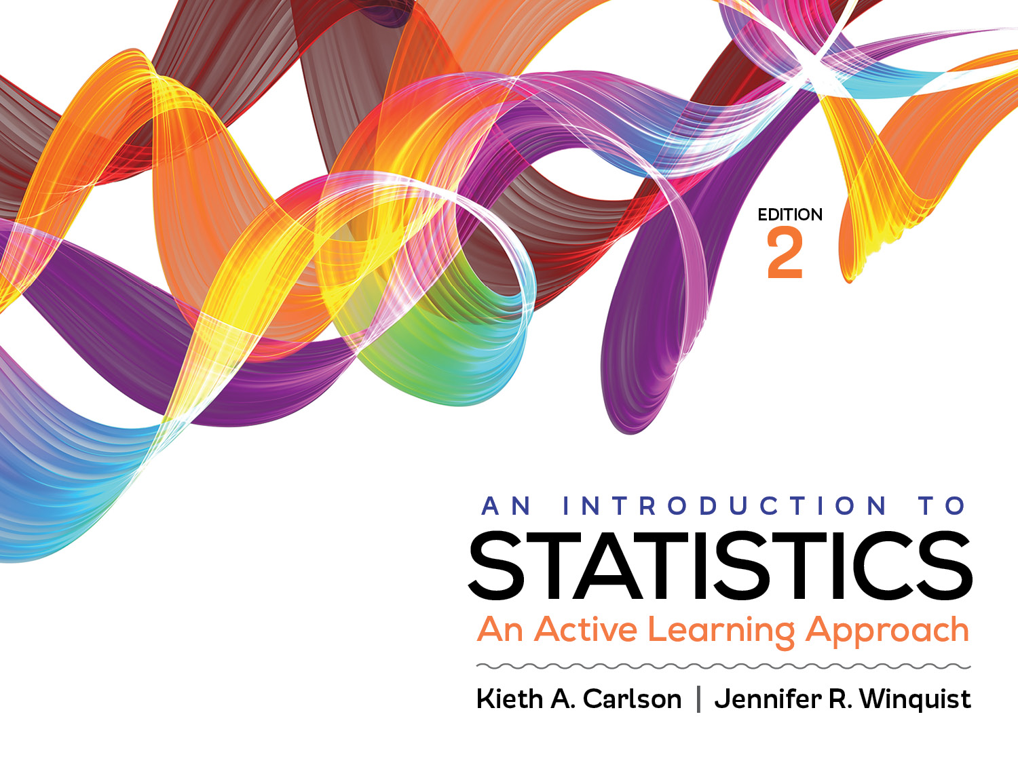
Introduction to Activity 14.2
Choosing the Correct Statistic

Slide 2
Activity 14.2 will require you to:
Choose the correct significance test for a given scenario
If necessary use Appendix J to help you

Slide 3
Which significance test and why?
Has voter satisfaction with a politician changed from what it was one year ago?
Do men enjoy violent movies more than women?
Are socio-economic (i.e., below average, average, and above average) and political affiliation (Democrat, Independent, and Republican) associated?
Do socio-economic (i.e., below average, average, and above average) and political affiliation (Democrat, Independent, and Republican) jointly effect attitudes about immigration (measured on a scale from 1 to 10)?
Are the proportions of citizens in each socio-economic status category (i.e., far below average, below average, average, etc.) equal?
Are the movie ratings different for Democrats, Independents, and Republicans?
Notes:
Repeated t test
Independent t test
Chi square for independence
2-way ANOVA
Goodness of fit Chi square
1-way ANOVA

